Slide 1
Functions
Recitation 6

Slide 2
Mid Term FCQ’s

Slide 3
Function Declaration
Signature of the function
returnType functionName(dataType variable …);
float calculateVolume(float radius);

Slide 4
Function Definition
Implementation of the function
returnType functionName(dataType variable …){
…
}
float calculateVolume(float radius){
return M_PI * radius * radius;
}

Slide 5
Function Call
float calculateVolume(float radius){
return M_PI * radius * radius;
}
int main(){
cout << calculateVolume(3.2) << endl;
return 0;
}

Slide 6
Function Ordering - 1
int main(){
cout << calculateVolume(3.2) << endl;
return 0;
}
float calculateVolume(float radius){
return M_PI * radius * radius;
}

Slide 7
Function Ordering - 2
float calculateVolume(float radius){
return M_PI * radius * radius;
}
int main(){
cout << calculateVolume(3.2) << endl;
return 0;
}

Slide 8
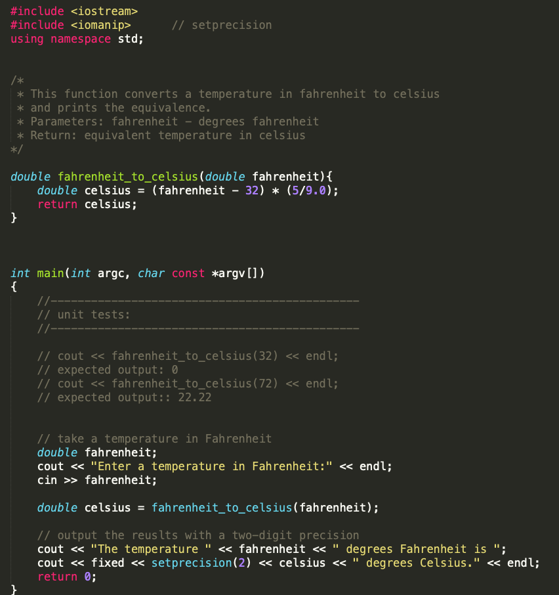
Sample Submission

Slide 9
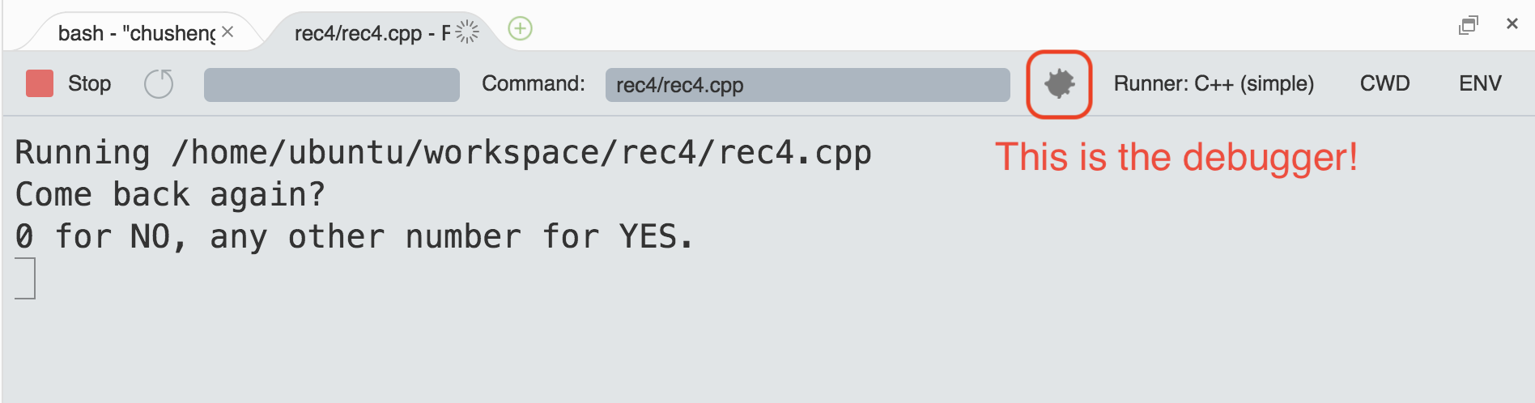
Debugger
A powerful tool to identify the bugs
Run step-by-step
Watch the value of variables

Slide 10
Announcements
Project 1 is due Saturday 6:00 PM
Sign-up for interview grading
Office hours
Regular 3 hours
1:1 meetings 1 hour – need to book through the scheduler
Out Of Town from Thursday onwards – please expect delayed replies

